Slide 1
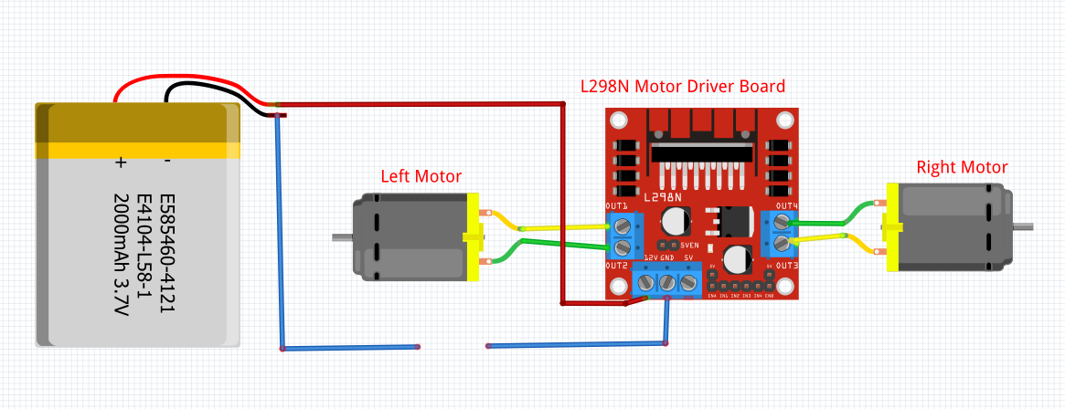
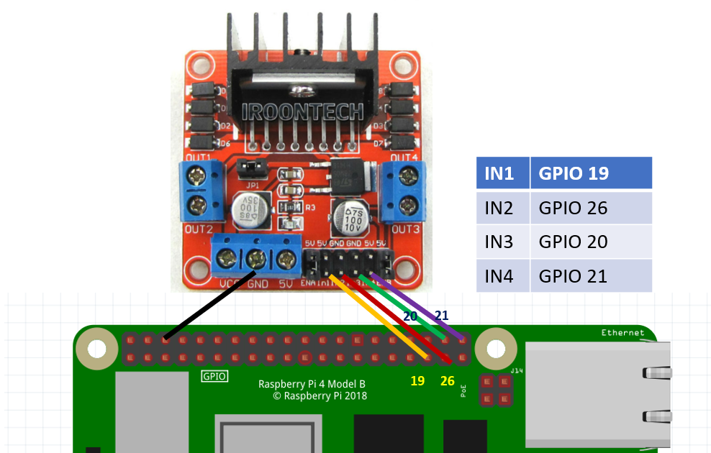
ROBOTIC CAR
WIRING DIAGRAM
VirusGenerator
VGAquarius090317
Test run RobotUnderCurses.py on you are done with the wiring

Slide 2
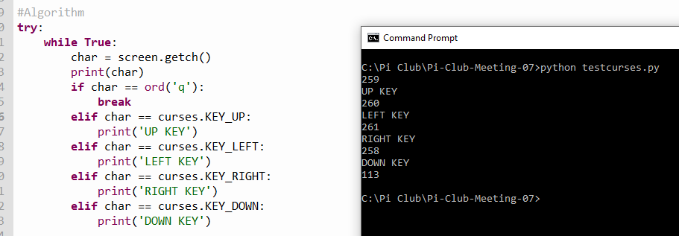

Explaining Curses and ord
Test ord() on Thonny shell

Slide 3
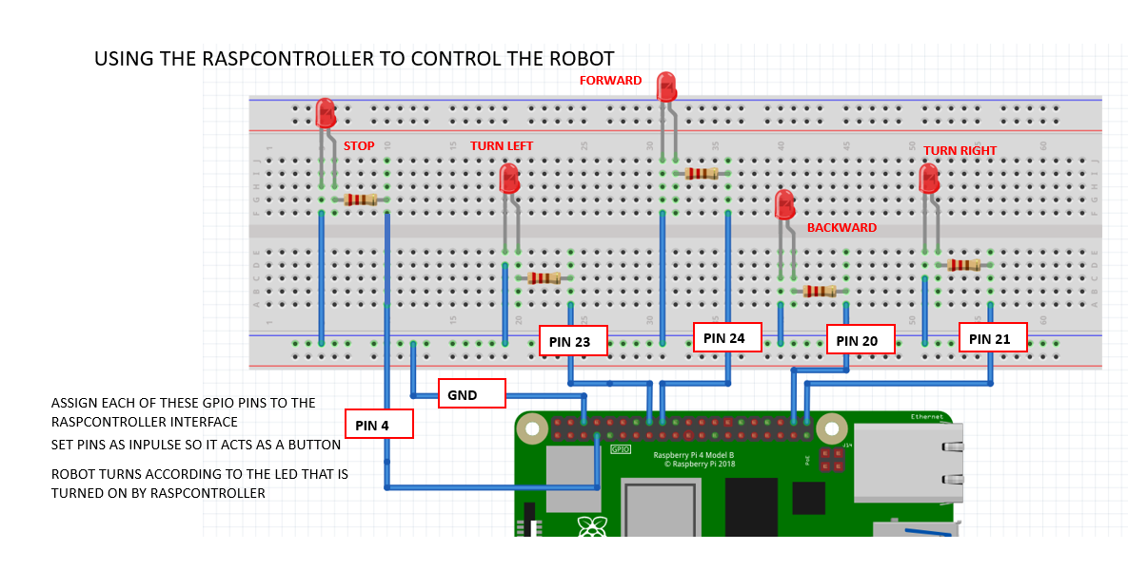
SET UP RASPCONTROLLER TO CONTROL GPIO PINS IN THE WIRING DIAGRAM
PIN 25
PIN 8

Slide 4
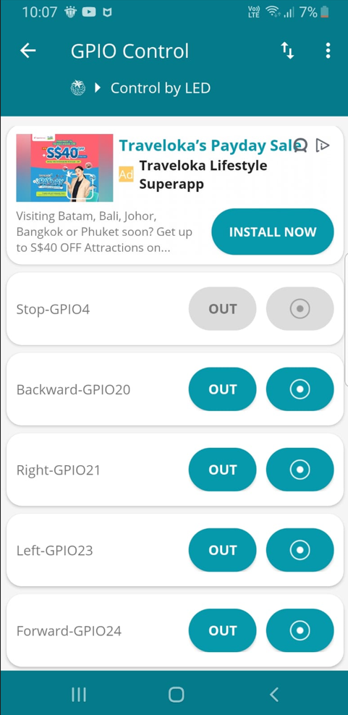
SET UP RASPCONTROLLER TO CONTROL GPIO PINS IN THE WIRING DIAGRAM

Slide 5
WAITING FOR KEYBOARD
WAITING FOR RASPCONTROLLER
while True:
char = screen.getch()
print(char)
if char == ord('q'):
break
if char == ord('s'):
robot.stop()
elif char == curses.KEY_UP:
robot.forward(.9)
elif char == curses.KEY_LEFT:
robot.left(.8)
sleep(.5)
robot.forward(.9)
elif char == curses.KEY_RIGHT:
robot.right(.8)
sleep(.5)
robot.forward(.9)
elif char == curses.KEY_DOWN:
robot.backward(.8)
while True:
if white_stop.is_lit:
initled()
robot.stop()
elif red_forward.is_lit:
robot.forward(.5)
elif yellow_left.is_lit:
robot.left(.3)
sleep(.001)
robot.forward(.5)
elif green_right.is_lit:
robot.right(.3)
sleep(.001)
robot.forward(.5)
elif blue_backward.is_lit:
blue_backward.off()
robot.backward(.5)
WHICH LED IS PRESSED
RaspcontrolerRobot.py

